Slide 1


Estimating abundance of Loligo Vulgaris in the Bay of Biscay with SPiCT model
Ane Iriondo, Leire Ibaibarriaga, Marina Santurtun

Slide 2

Introduction: Squid in the Bay of Biscay
Available data: abundance index from EVHOE survey and total landings from WGCEPH
SPiCT production model parametrization based on an analysis script done for Indian mackerel by Leire Ibaibarriaga
Conclusions
.

Slide 3
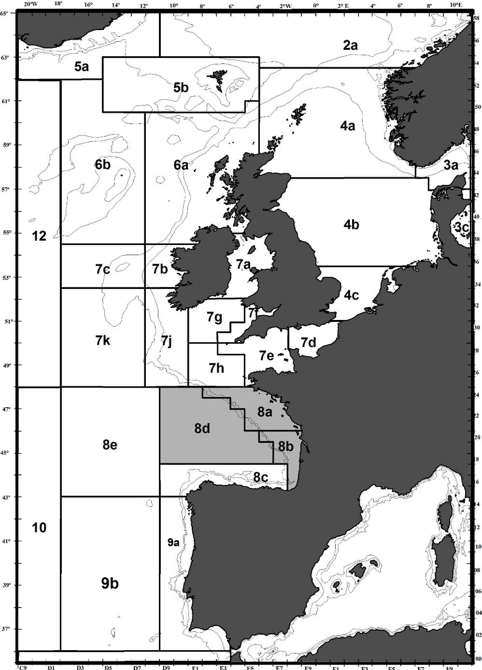
SQUID IN THE BAY OF BISCAY
Short-lived species.
High natural mortality.
Large interannual fluctuations.
Very-dependent on environment.
Distributed from ICES Subarea 3 to Division 9a, Mediterranean waters and North African coast.
ICES considers all the information in 8abd as a unit.
.

Slide 4
ABUNDANCE INDEX
Fishery-independent abundance index from EVHOE survey for all Loligo spp.
Disaggregated by species according to the percentage of the survey catches corresponding to each species.
.

Slide 5
LANDINGS
Exploited in a multi-specific and mix-fisheries trawlers.
Information on landings by country and ICES area 8abd.
When there is no disaggregation by species, we assumed the same % as in the EVHOE survey.
.

Slide 6
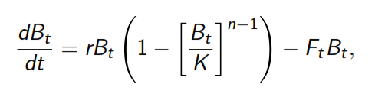
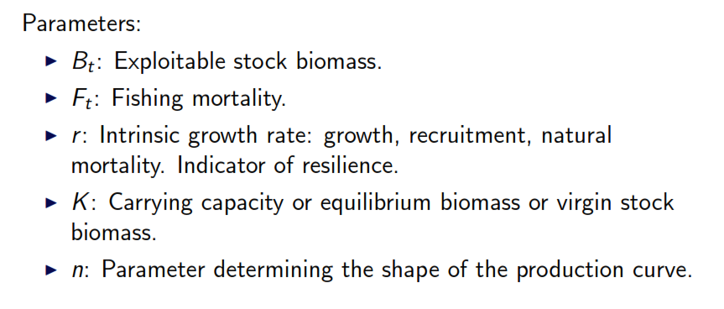
Surplus production model
Pella & Tomlinson (1969):
.

Slide 7

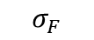
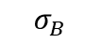
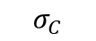
SPICT (Stochastic surplus production model in continuous time)
BIOMASS
PROCESS
$$σ_{B}$$
PROCESS ERROR
FISHING
PROCESS
$$σ_{F}$$
PROCESS ERROR
$$σ_{I}$$
OBSERVATIONS
OBSERVATION ERRORS
$$σ_{C}$$

Slide 8
SPiCT Model advantages:
Separation of process and observation noise.
Observation error on both index and catch.
Irregular sampling intervals allowed.
Seasonal dynamics can be accommodated.

Slide 9
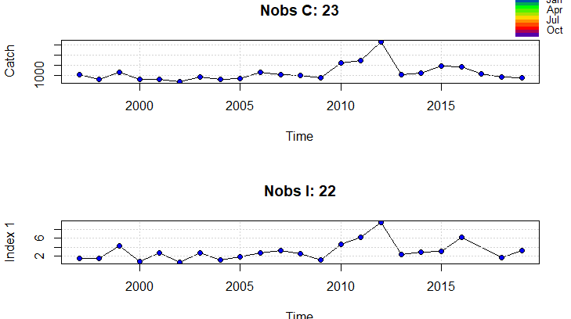
Input data

Slide 10
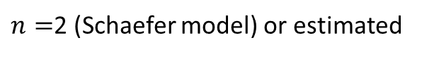
SPiCT parameters:
Often there is not enough information to estimate all model parameters, it is therefore important to quantify parameter uncertainty.
Data contained too little information to allow unconstrained estimation of parameters α, β and n.
Therefore several attempts fixing parameters were done to analyse the different convergence of the model.
$α=\frac{σ_{I}}{σ_{B}}$: ratio between observation and process error for Index and Biomass
$β=\frac{σ_{C}}{σ_{F}}:$ ratio between observation and process error for Catch and F
$n=$2 (Schaefer model) or estimated

Slide 11
SPiCT runs: 12 cases parameters fixing
Model selection criteria: AIC
SPICT | n=estimated | n=2 | n=estimated | n=2
Convergence |  |  | Prior r logr ~N(log(1), 1) | Prior r
α estimated | Case 1a=NO | Case 4a=NO | Case 1b= 104.6227 | Case 4b=NO
β estimated
α=1 | Case 2a= 81.02054 | Case 5a= 68.46823 | Case 2b= 83.49258 | Case 5b= 70.30613
β=1
α=4 | Case 3a= 86.70934 | Case 6a= 71.87238 | Case 3b= 89.2018 | Case 6b= 74.01433
β=1
Notes:
El parámetro n nos da la forma de la curva de producción. Cuando n=2 se corresponde con el modelo de Schaeffer y la curva es simétrica. Biológicamente es discutible si la curva es simétrica o no, pero si no se puede estimar bien ese parámetro es una asunción bastante común. En el artículo de Pedersen and Berg (2016) en el ejercicio de simulación, ellos ponen algo así:
We assessed to which extent models of different complexity were identifiable given the data by first estimating a baseline model with a spline-based
seasonal representation while fixing a = 1 and n = 2, which are standard assumptions (Ono et al. 2012; Thorson et al. 2013) and fixing b = 1.
Luego en la discusión también ponen que ellos estiman bien la n, pero como en este caso hay mucha incertidumbre, si vamos a fijar algo, fijar la n es como lo más fácil…

Slide 12
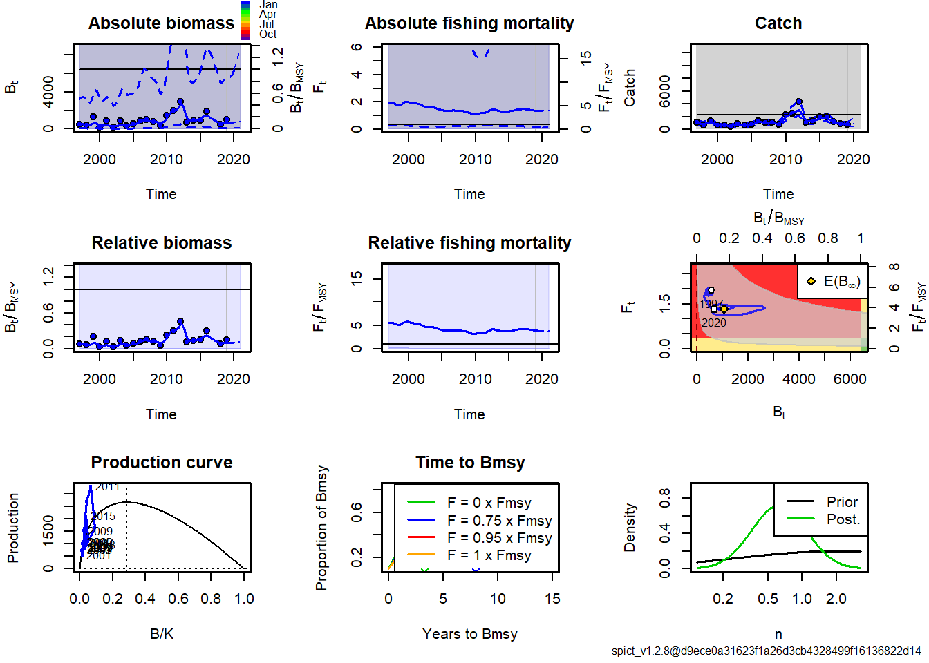
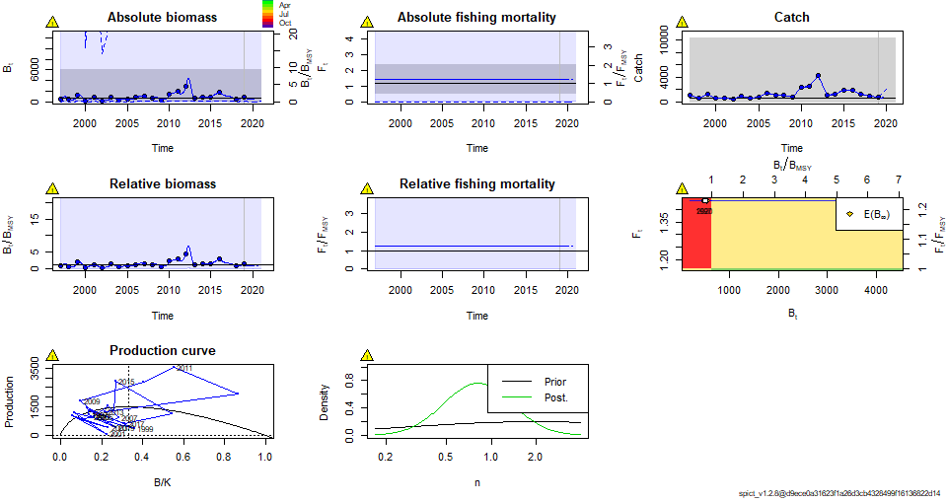
Fitting the model: Case 1a
(α, β, n=estimated)
Fitting the model: Case 2a
(α= β=1, n=estimated)
## Convergence: 1 MSG: false convergence (8) ## WARNING: Model did not obtain proper convergence! Estimates and uncertainties are most likely invalid and cannot be trusted.
Convergence: 0 MSG: relative convergence (4)

Slide 13
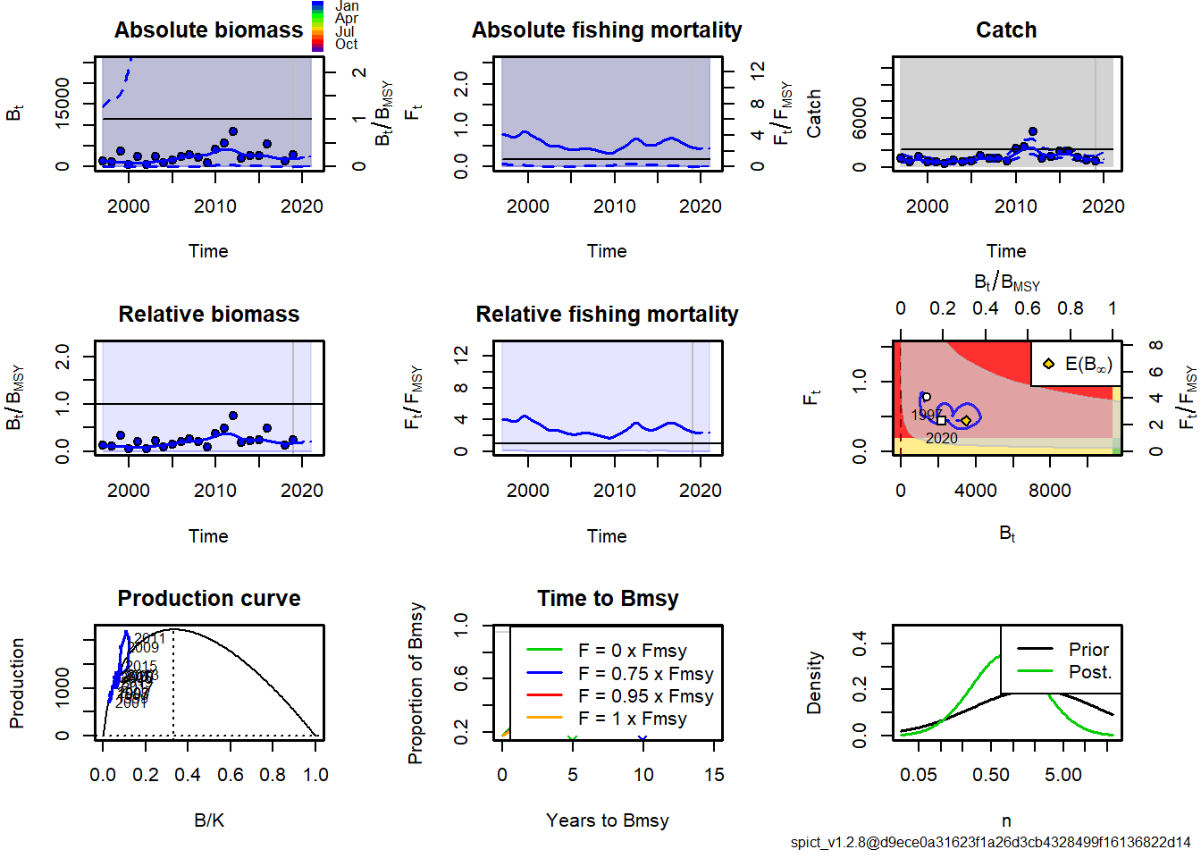
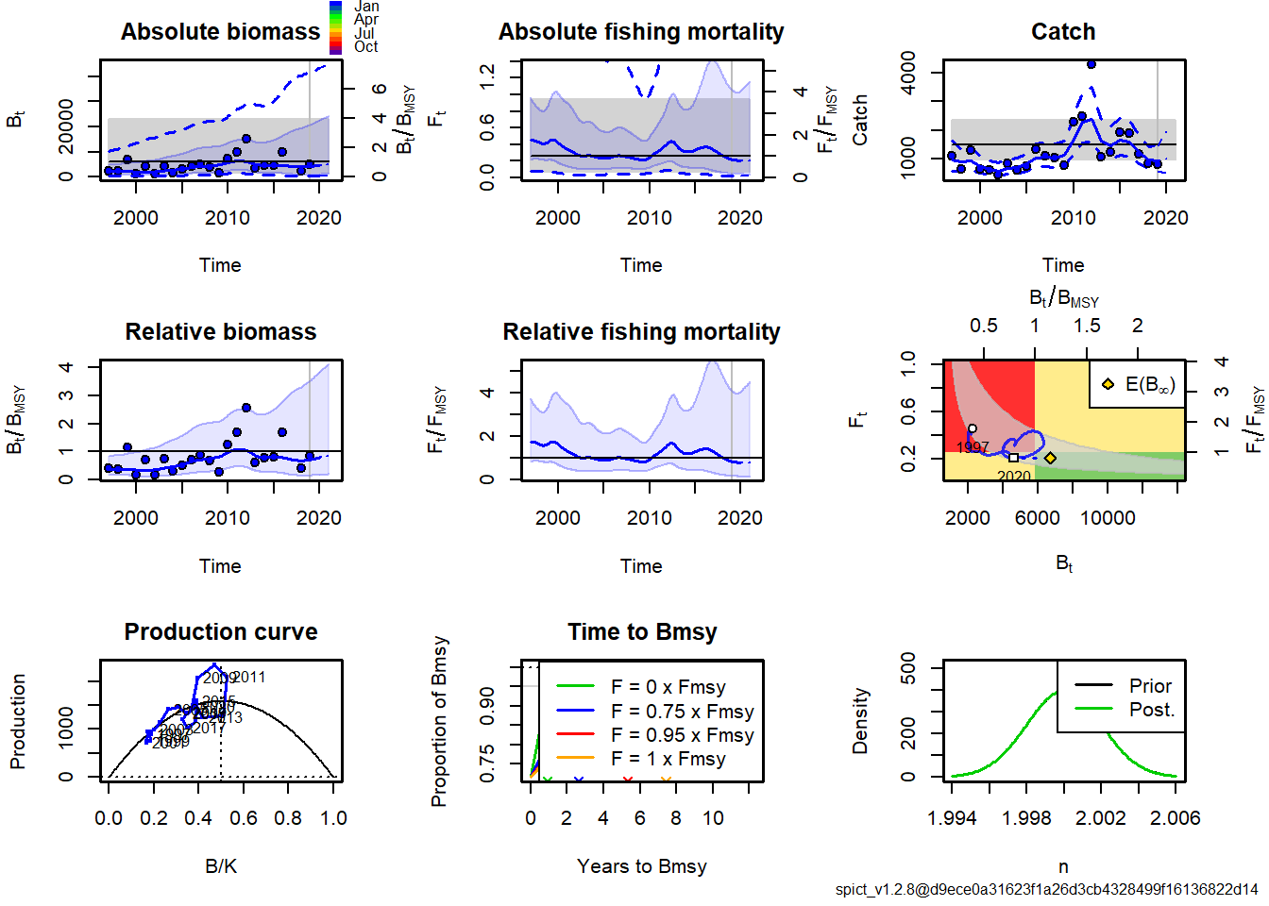
Fitting the model: Case 3a
(α=4, β=1, n=estimated)
Fitting the model: Case 6a
(α=4, β=1, n=estimated)

Slide 14
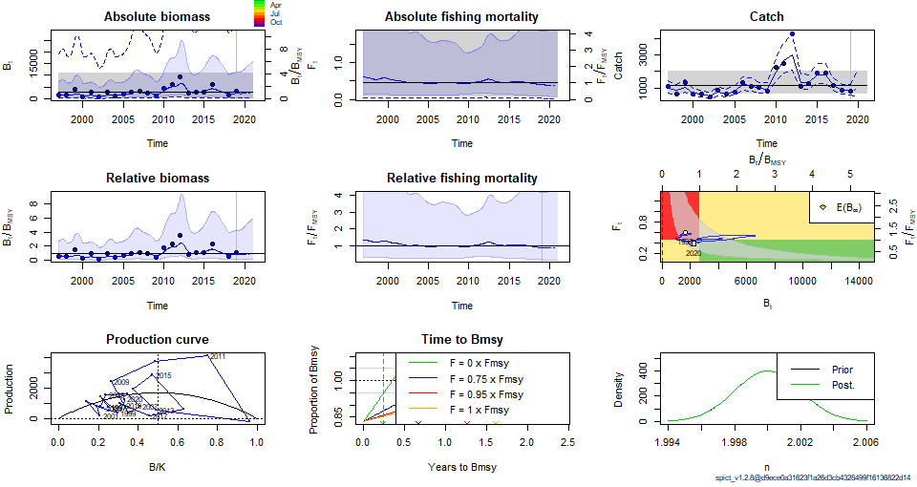
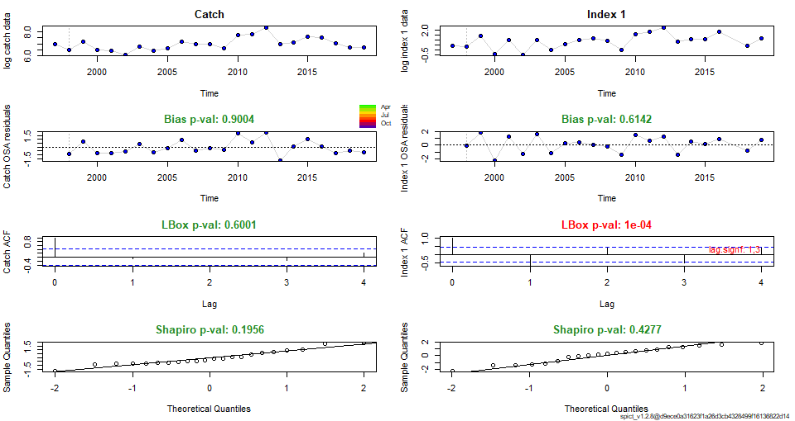
PROPOSED FINAL MODEL: Case 5a:
α = β =1 and n=2 (Schaefer model)
Assessment results
Residual diagnostics

Slide 15
PROPOSED FINAL MODEL: Case 5a:
α = β =1 and n=2 (Schaefer model)
REFERENCE POINTS
MODEL PARAMETERS and 95% CI
Convergence: 0 MSG: relative convergence (4)
Objective function at optimum: 26.2341151
Euler time step (years): 1/16 or 0.0625
Nobs C: 23, Nobs I1: 22
Priors
logn ~ dnorm[log(2), 0.001^2] (fixed)
logalpha ~ dnorm[log(1), 0.001^2] (fixed)
logbeta ~ dnorm[log(1), 0.001^2] (fixed)
Model parameter estimates w 95% CI
estimate cilow ciupp log.est
alpha 0.9999987 0.9980406 1.001961e+00 -0.0000013
beta 1.0000020 0.9980439 1.001964e+00 0.0000020
r 1.0061880 0.2853067 3.548512e+00 0.0061689
rc 1.0061900 0.2853071 3.548521e+00 0.0061709
rold 1.0061920 0.2853067 3.548540e+00 0.0061729
m 1702.5889030 1014.1755846 2.858291e+03 7.4399053
K 6768.4640484 1514.1206205 3.025658e+04 8.8200295
q 0.0010155 0.0000961 1.073480e-02 -6.8924056
n 1.9999961 1.9960799 2.003920e+00 0.6931452
sdb 0.4886517 0.3622857 6.590946e-01 -0.7161052
sdf 0.2110432 0.1275477 3.491968e-01 -1.5556923
sdi 0.4886511 0.3622862 6.590919e-01 -0.7161065
sdc 0.2110437 0.1275482 3.491968e-01 -1.5556902
Deterministic reference points (Drp)
estimate cilow ciupp log.est
Bmsyd 3384.229461 757.0590772 15128.28970 8.1268815
Fmsyd 0.503095 0.1426536 1.77426 -0.6869763
MSYd 1702.588903 1014.1755846 2858.29103 7.4399053
Stochastic reference points (Srp)
estimate cilow ciupp log.est rel.diff.Drp
Bmsys 2667.393455 653.4100119 10889.009523 7.8888570 -0.2687403
Fmsys 0.450143 0.1052668 1.924907 -0.7981899 -0.1176337
MSYs 1162.750687 669.2667943 2020.104945 7.0585438 -0.4642768
STOCK STATUS
B_2019.00 2219.611 163.948 30050.218782 7.7050873
F_2019.00 0.402133 0.0285682 5.660516 -0.9109724
B_2019.00/Bmsy 0.8321274 0.1648653 4.200010 -0.1837697
F_2019.00/Fmsy 0.8933449 0.1914966 4.167517 -0.1127825
Biomass below Bmsy
F below Fmsy

Slide 16
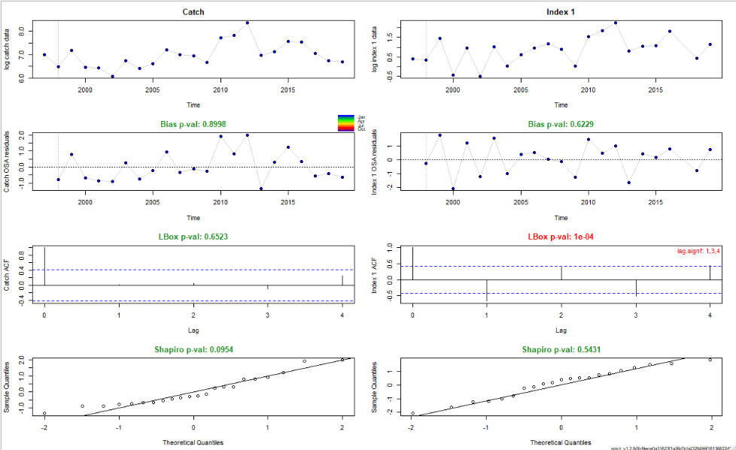
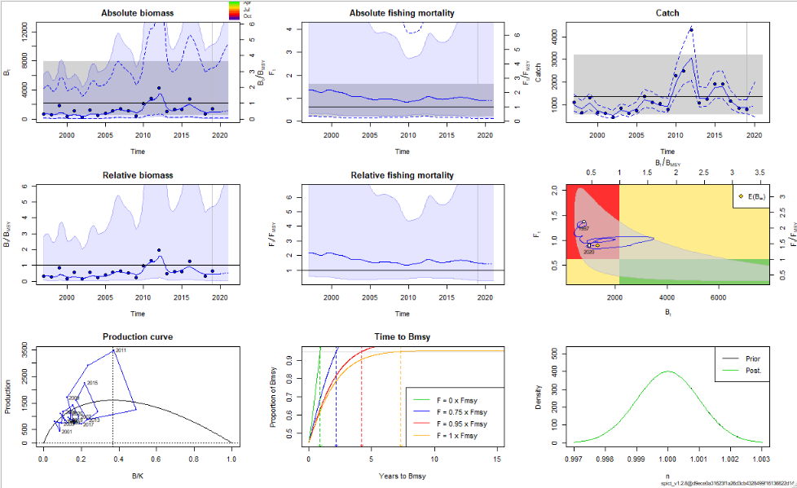
PROPOSED FINAL MODEL: Case 5a:
α = β =1 and n=1 UPDATED
Assessment results
Residual diagnostics

Slide 17
FINAL MODEL: Case 5a:
α = β =1 and n=1 UPDATED
REFERENCE POINTS
MODEL PARAMETERS and 95% CI
Convergence: 0 MSG: both X-convergence and relative convergence (5)
Objective function at optimum: 25.1074835
Euler time step (years): 1/16 or 0.0625
Nobs C: 23, Nobs I1: 22
Priors
logn ~ dnorm[log(1), 0.001^2] (fixed)
logalpha ~ dnorm[log(1), 0.001^2] (fixed)
logbeta ~ dnorm[log(1), 0.001^2] (fixed)
Model parameter estimates w 95% CI
estimate cilow ciupp log.est
alpha 9.999974e-01 0.9980394 1.001959e+00 -0.0000026
beta 1.000002e+00 0.9980436 1.001964e+00 0.0000017
r 6.258727e-01 0.2422680 1.616873e+00 -0.4686082
rc 1.251747e+00 0.4845381 3.233740e+00 0.2245401
rold 5.340018e+05 0.0000000 1.505254e+306 13.1881545
m 1.602940e+03 691.6027124 3.715163e+03 7.3795947
K 6.961863e+03 1860.3474542 2.605295e+04 8.8482024
q 2.243200e-03 0.0004238 1.187510e-02 -6.0998377
n 9.999988e-01 0.9980408 1.001961e+00 -0.0000012
sdb 5.081752e-01 0.3659910 7.055965e-01 -0.6769291
sdf 2.049723e-01 0.1203473 3.491034e-01 -1.5848802
sdi 5.081739e-01 0.3659912 7.055925e-01 -0.6769317
sdc 2.049727e-01 0.1203477 3.491034e-01 -1.5848786
Deterministic reference points (Drp)
estimate cilow ciupp log.est
Bmsyd 2561.1247920 684.384022 9584.32692 7.8482018
Fmsyd 0.6258735 0.242269 1.61687 -0.4686071
MSYd 1602.9400360 691.602712 3715.16293 7.3795947
Stochastic reference points (Srp)
estimate cilow ciupp log.est rel.diff.Drp
Bmsys 2176.6090731 597.2736464 7932.08789 7.685524 -1.766581e-01
Fmsys 0.6258735 0.2422691 1.61687 -0.468607 6.334159e-08
MSYs 1362.2820060 579.5117777 3202.37195 7.216916 -1.766580e-01
STOCK STATUS
States w 95% CI (inp$msytype: s)
estimate cilow ciupp log.est
B_2019.00 970.6322353 134.1744828 7021.655061 6.8779476
F_2019.00 0.9288235 0.1226951 7.031358 -0.0738366
B_2019.00/Bmsy 0.4459378 0.0422581 4.705851 -0.8075758
F_2019.00/Fmsy 1.4840434 0.2823680 7.799697 0.3947704
Biomass 2019 below Bmsy
F 2019 above Fmsy

Slide 18
Conclusions:
There are still many data issues not fully resolved yet like species identification and knowledge on cephalopod biology and fisheries.
Additional assumptions were needed to get model convergence. Results are still highly uncertain.
Additional information on the stock, like a recruitment index would allow considering alternative models, more suitable for short-lived stocks.
In the parameters fixing exercise done in WGCEPH 2020 the biological significance of the fixing was discussed and should be reviewed.

Slide 19




